Slide 1
Real Time Signals
Embedded Systems
PIC16F877A
Module-5
ADC

Slide 2
Agenda
Analog to digital circuit
Introduction to analog to digital conversion
Inbuilt A/D converter
ADC data registers
Analog inputs
Reading ADC
Sensors
Introduction to sensors
Types of sensors
IR sensor
Light sensor
Temperature sensor
Gas sensor
Motion sensor
Sensor interfacing in PIC16F877A
Analog Comparator

Slide 3
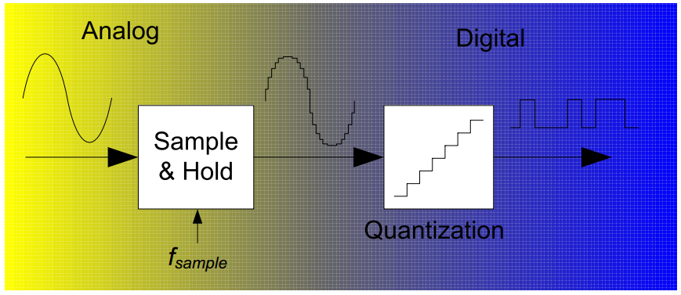
Introduction to analog to digital conversion
An ADC inputs an analog electrical signal such as voltage or current and outputs a binary numbers
The more bits the binary number has, the higher the resolution of the - A/D.
The low resolution A/D takes less time than the conversion time of the high resolution A/D.

Slide 4
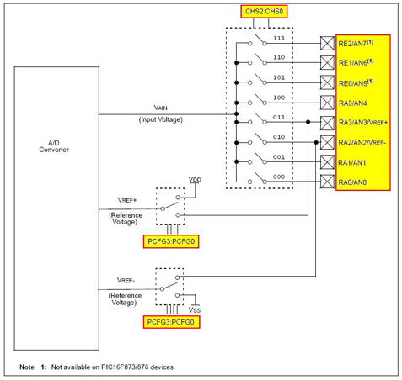
Analog to digital converter of PIC16F877A
A/D Block Diagram
8 inputs
Output consists of 10 bit digital number
PORTA and PORTE are multiplexed with the analog pins

Slide 5

Analog to digital converter of PIC16F877A
High Resolution
Resolution of ten-bit length.
Divides the analog input voltage between 0v and 5v to 2^ 10 levels
i.e.,1024 levels.
Calculating the binary value of the analog input voltage
Use the triangle method
For example, the binary value representation on the analog input voltage of 3.65 volt:
3.65v will be represented by decimal number 748 or by binary number 1011101100

Slide 6
ADC DATA REGISTERS
The A/D module has four 8 bit registers
ADCON0 - A/D Control Register 0
determines the behaviour of the A/D
ADCON1 - A/D Control Register 1
determines the configuration of the PORTA and PORTE
how the result of conversion of A/D will be store
ADRESH - A/D Result High Register
ADRESL - A/D Result Low Register

Slide 7

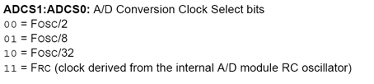
ADCON0 Register
Select clock frequency used for internal synchronization of A/D converter
It also affects duration of conversion.

Slide 8
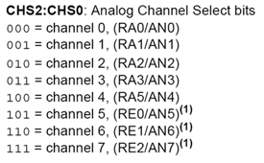
ADCON0 Register Continued
ANALOG CHANNEL SELECT BIT
Used to select the input channel

Slide 9
ADCON0 Register Continued
GO/DONE: A/D Conversion Status bit
If ADON = 1:
1 = A/D conversion in progress
(setting this bit starts the A/D conversion)
0 = A/D conversion not in progress
(this bit is automatically cleared by hardware when the A/D conversion is complete)
ADON: A/D On bit
1 = A/D converter module is operating
0 = A/D converter module is shut-off and consumes no operating current

Slide 10



ADCON1 Register
ADFM: A/D Result Format Select bit
1 = Right justified.
0 = Left justified.
Alignment to the left
Alignment to the right

Slide 11
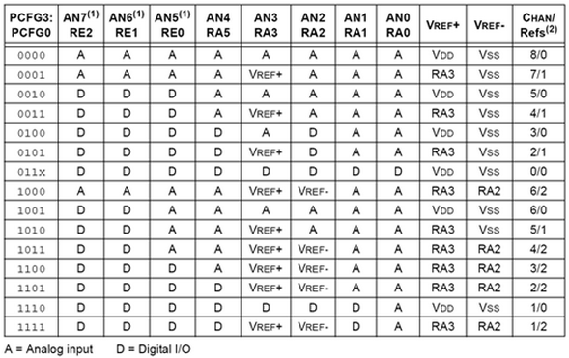
ADCON1 Register continued
ADCS2: Conversion clock select bit
PCFG3:PCFG0: A/D Port Configuration Control bits
Used to configure pins as analog input/ digital i/o port

Slide 12
#include<htc.h>
#define _XTAL_FREQ 8000000
void main()
{
unsigned int a;
TRISB = 0x00;
TRISC = 0x00;
ADCON0 = 0xC1;
ADCON1 = 0xC0;
while(1)
{
ADCON0 = 0xC5;
while(GO_DONE);
a=((ADRESH<<8)+ADRESL);
PORTB = a;
PORTC = a>>8;
__delay_ms(100);
}
}

Slide 13
End of Module 5

